Slide 1
CRUNCHY BITS
presents

Slide 2
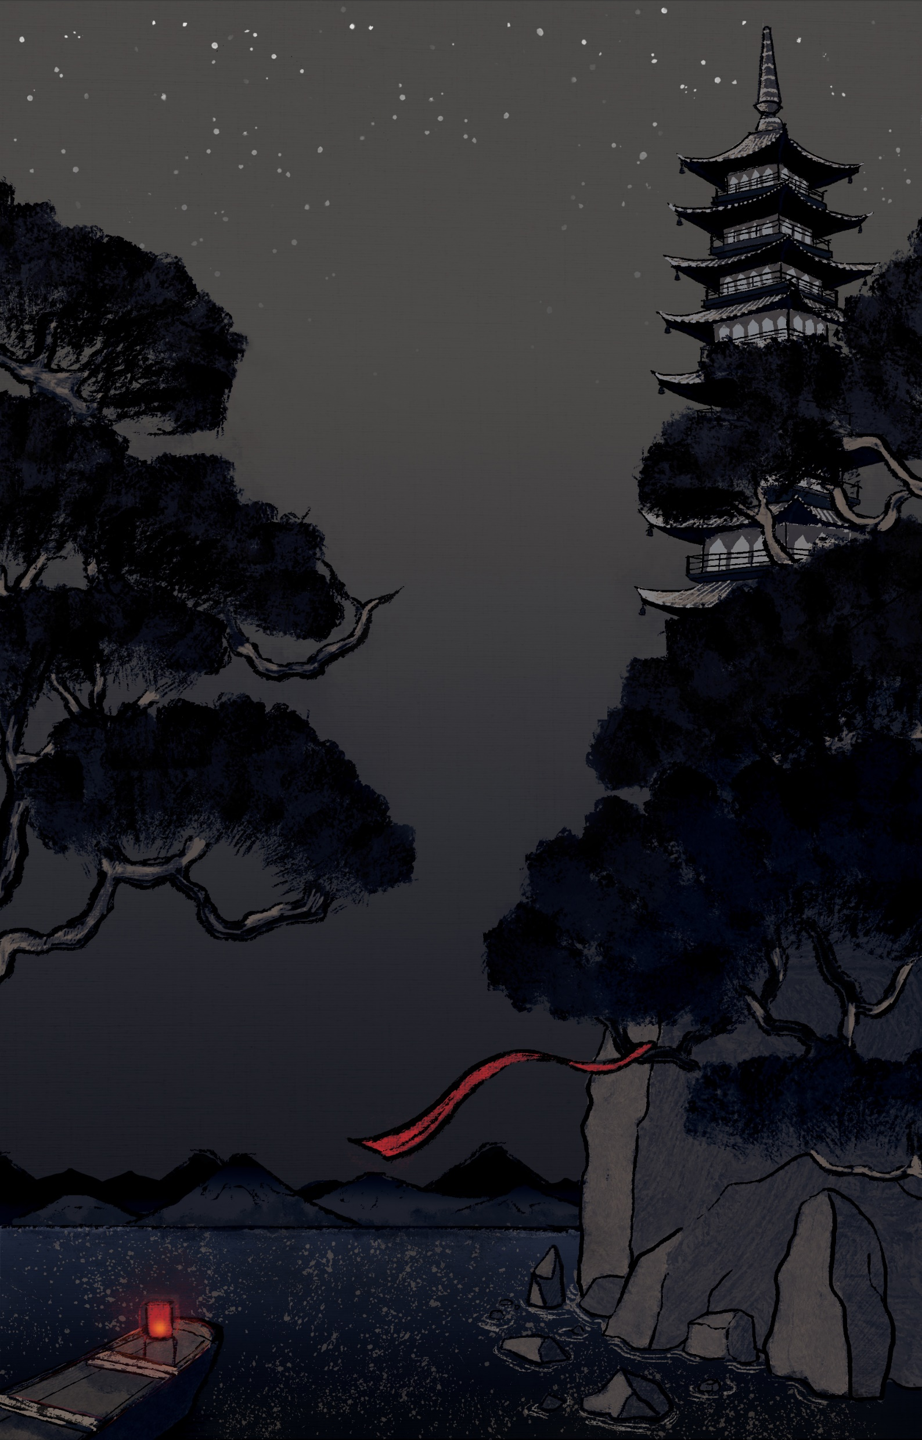


Slide 3
Project Goals
1: Concentrate on one simple mechanic but make it pop!
2: Polish it until it shines.

Slide 4
Scope
Must Have | Should Have | Nice to Have
Swiping Combat Mechanic ✔ | Particle Effects ✔ | Bosses CUT
Enemies x3 ✔ | Adaptive UI ✔ | Enemies x6 ✔
Player Character ✔ | Overworld ✔ | Level x3 ✔
Animations ✔ | Score ✔ | Achievements CUT
Level x1 ✔ | Stylized 3D Environments ✔ | Unlockables (Skins) CUT
SFX ✔ | Traditional Instrumentation ✔
 | Unique Monster Sounds ✔

Slide 5
DEVLOG

Slide 6
Ole Ortmann
Uses Pepsi as mouthwash

Slide 7
Hendrik Wagner
Has earned his Feierabendbier

Slide 8
Victor Hübner
Just one more frame…

Slide 9
Angeli Fernando
This is the seventh iteration of this subtitle because Victor said the previous ones all had a style clash problem

Slide 10
Michael Wick
Still lives with his Mom

Slide 11
Waiyaki Otieno
Totally not toxic

Slide 12
Zhu Zhaoliang
Likes chicken teriyaki

Slide 13




In-game Music
instrumentation
melodic
rhythm
texture

Slide 14
Sound Design
In-game SFX
inspiration
Idea

Slide 15
Mohamad Sharkawi
(Not a terrorist)

Slide 16
Katharina Bornemann
“You can choose my subtitle”

Slide 17
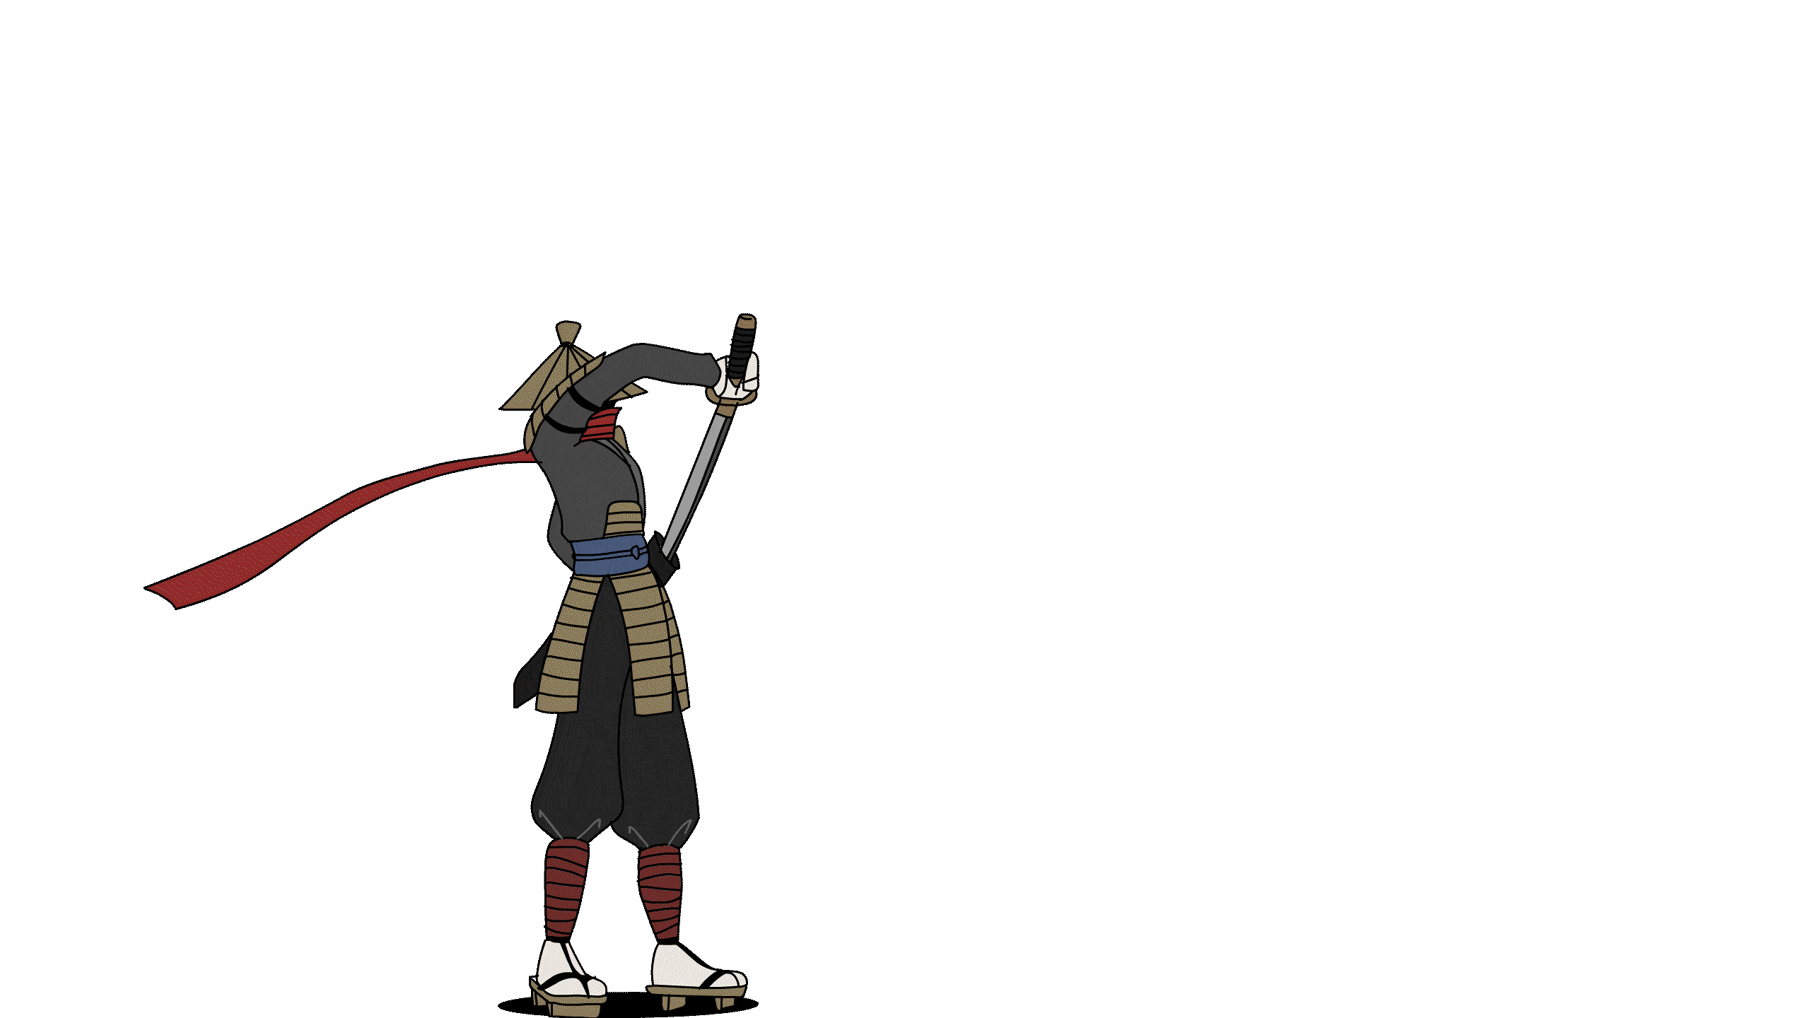
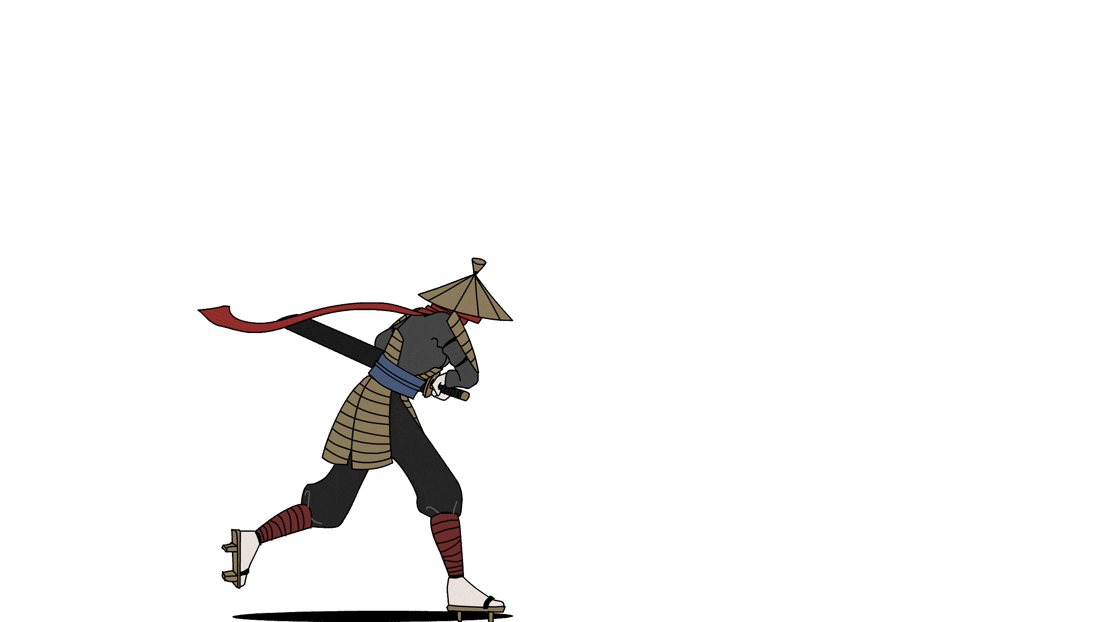
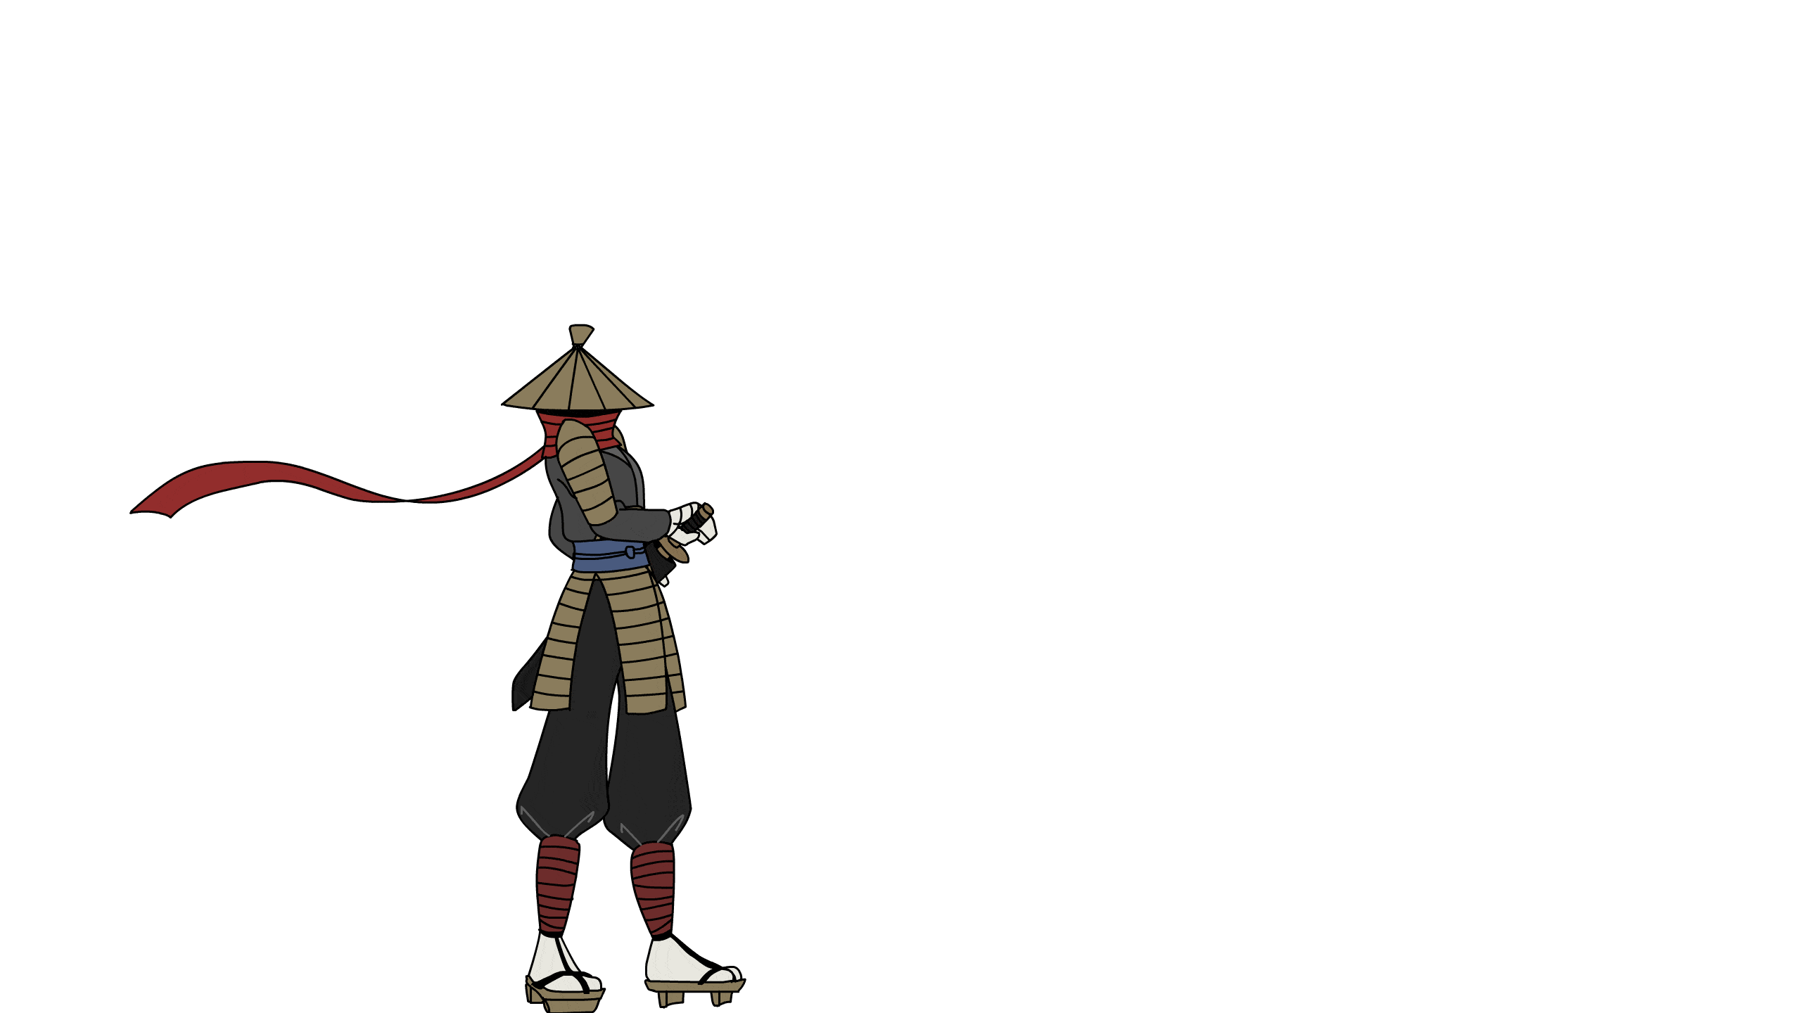
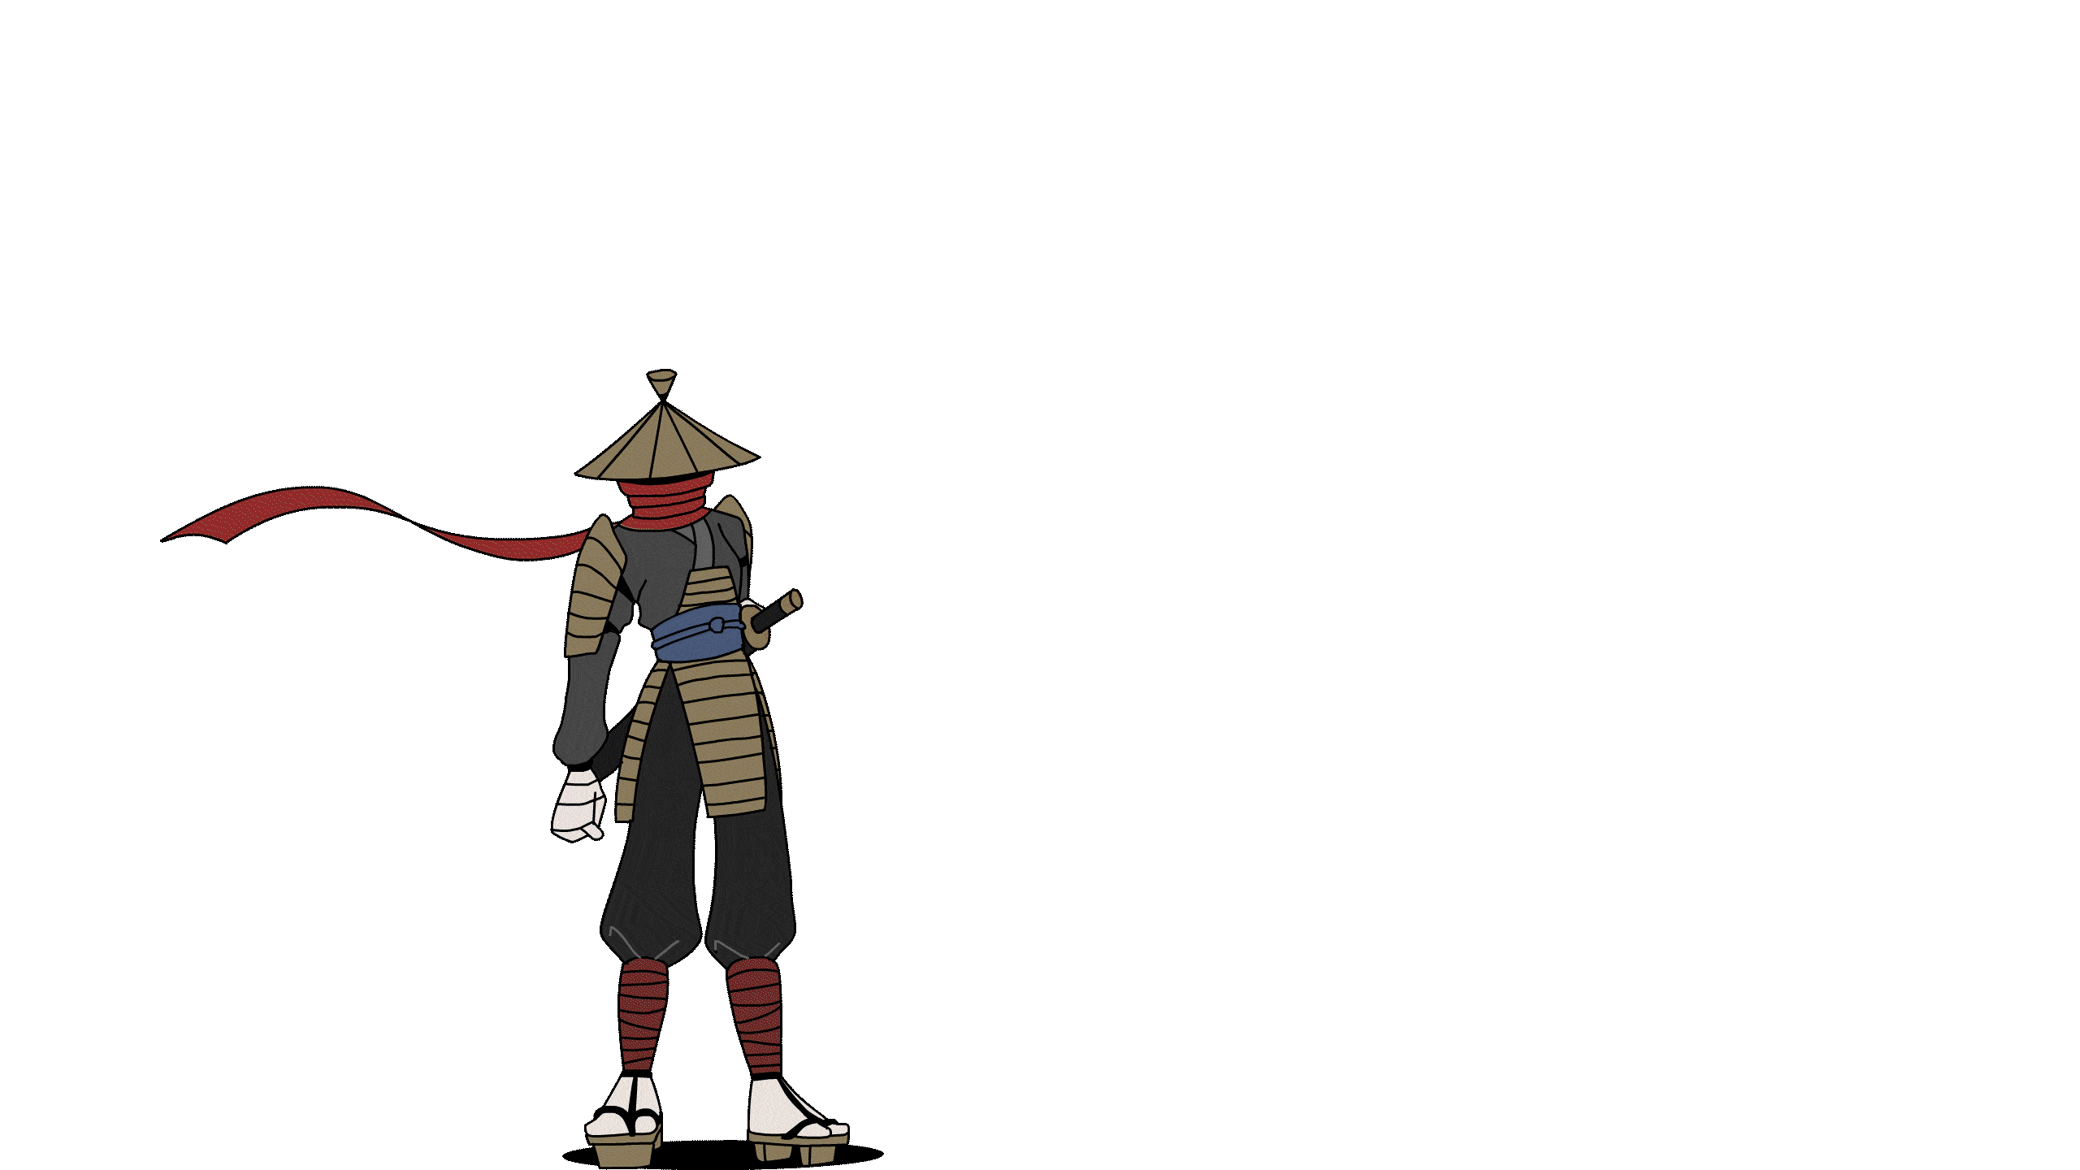
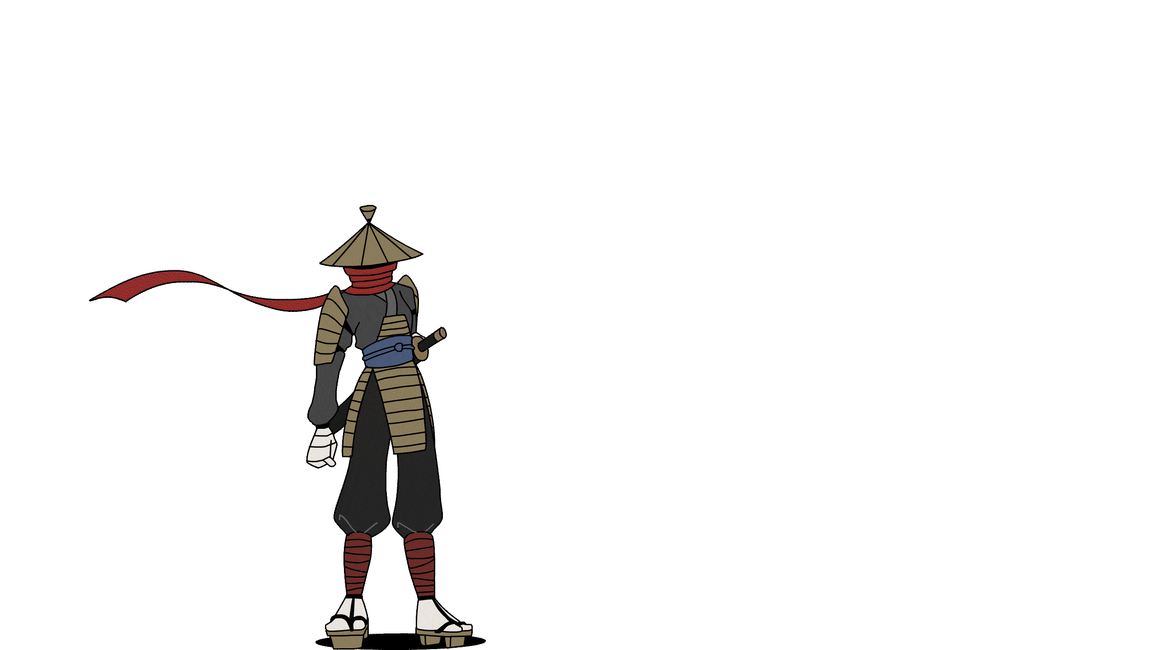
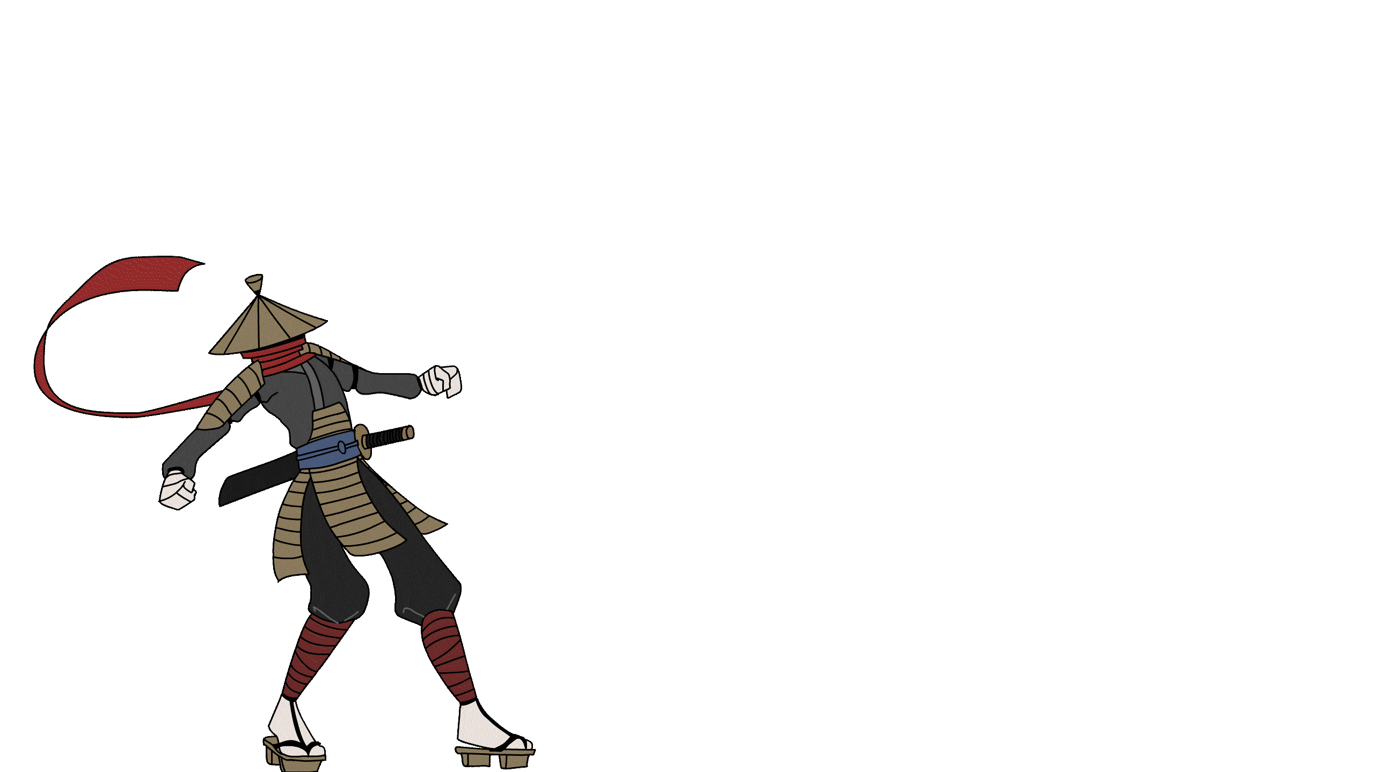
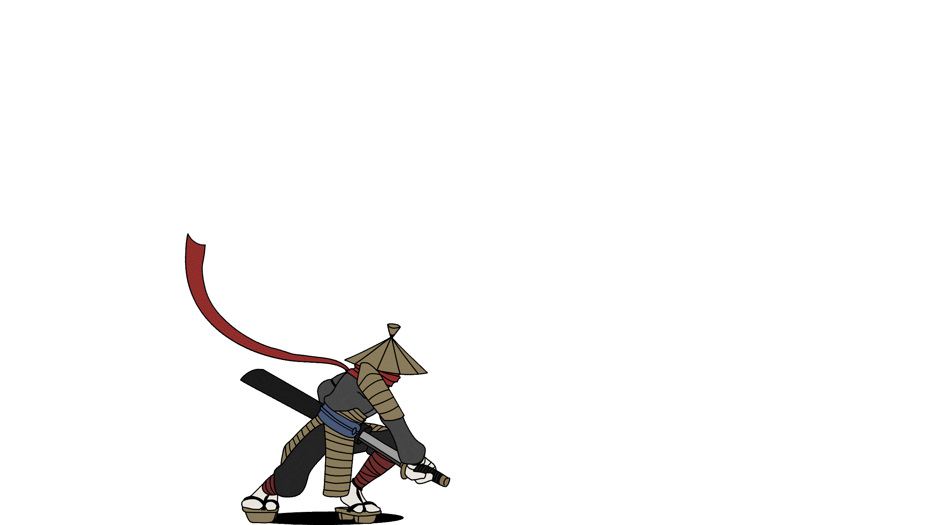
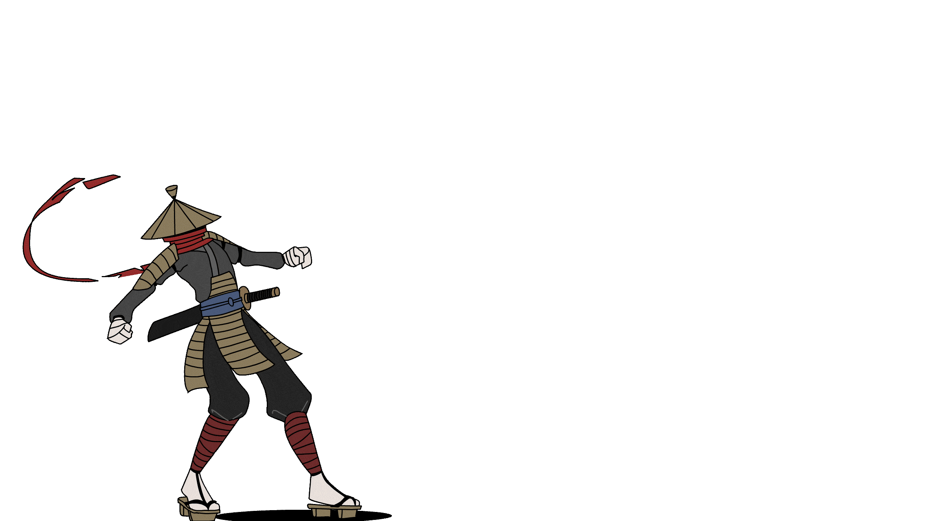


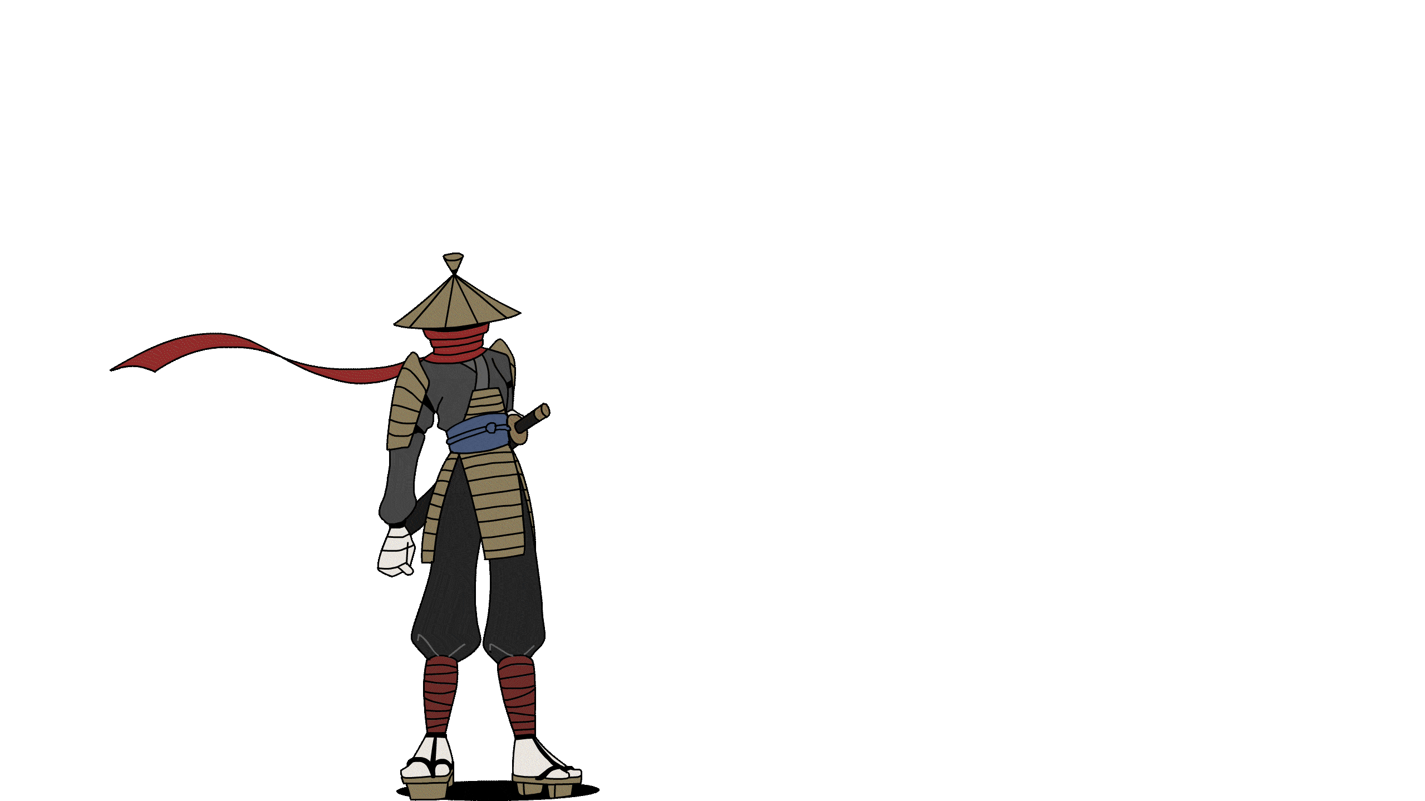

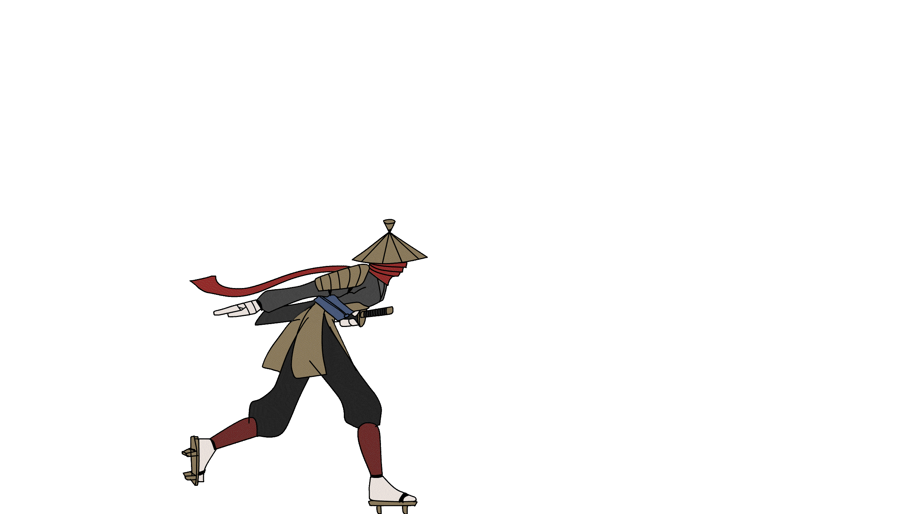
So many animations…

